Slide 1
What Month Were You Born In?

Slide 2
Frequency table & bar graph
Month | Frequency
1 | 6
2 | 2
3 | 6
4 | 2
5 | 4
6 | 2
7 | 5
8 | 2
9 | 6
10 | 4
11 | 4
12 | 7
frequency
Month

Slide 3
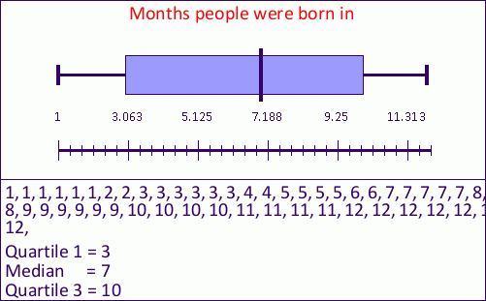
Box and Whisker plot
Max: 12
Min: 1
Median: 7
Q1: 3
Q3: 10

Slide 4
The Median
The median of our data set is 7, it the middle value of a numerical set of data.
1,1,1,1,1,1,2,2,3,3,3,3,3,3,4,4,5,5,5,5,6,6,7,7,7,7,7,8,8,9,9,9,9,9,9,10,10,10,10,11,11,11,11,12,12,12,12,12,12,12

Slide 5
Mean
The mean is 6.82, or closest to 7, or June. The mean is the average of a data set.
Range
11 is our range. Range is max-min
Mode
12 is the mode, or the most repeated number (month).

Slide 6
Standard Deviation
The standard deviation of our data set is 3.77. To find the standart deviation you enter your list of data into your calculator. It shows you how far away the data will get from the mean.

Slide 7
Conclusion
In conclusion, most people were born in the month of December.

