Slide 1
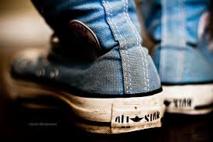
Shoe Sizes

Slide 2
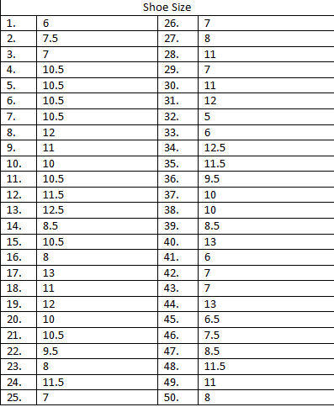
My Participants
What’s Your Shoe Size?

Slide 3
Frequency Table
Shoe Size | Number of People
5 | 1
5.5 | 0
6 | 3
6.5 | 1
7 | 6
7.5 | 2
8 | 4
8.5 | 3
9 | 0
9.5 | 2
10 | 4
10.5 | 7
11 | 5
11.5 | 4
12 | 4
12.5 | 1
13 | 3

Slide 4
Bar Graph
Frequency
Shoe Size

Slide 5
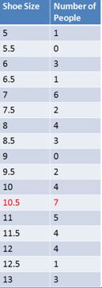
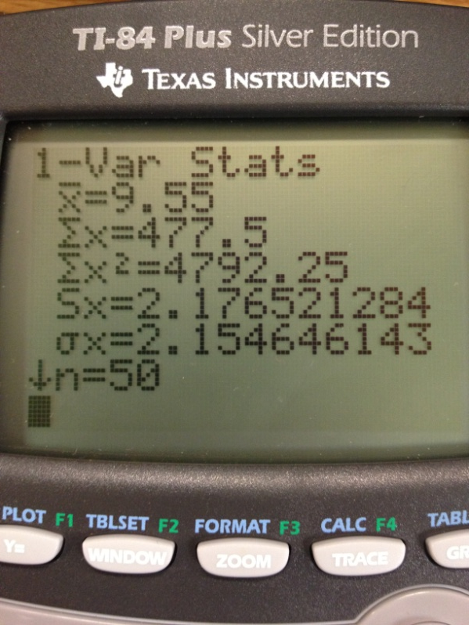
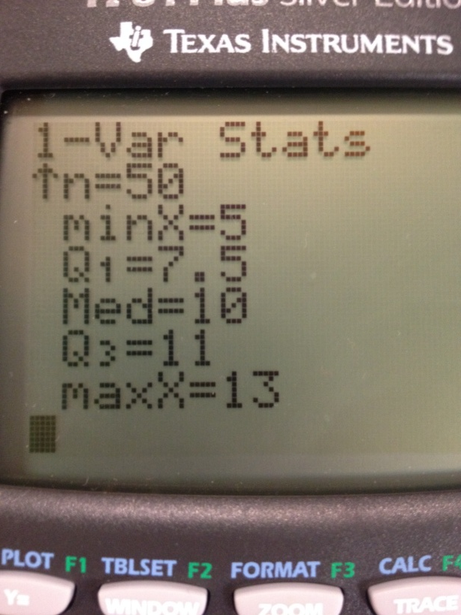
Mean, Median, and Mode
Mean: the average of numbers
Median: the middle range of numbers
Mode: the number that occurs most often

Slide 6
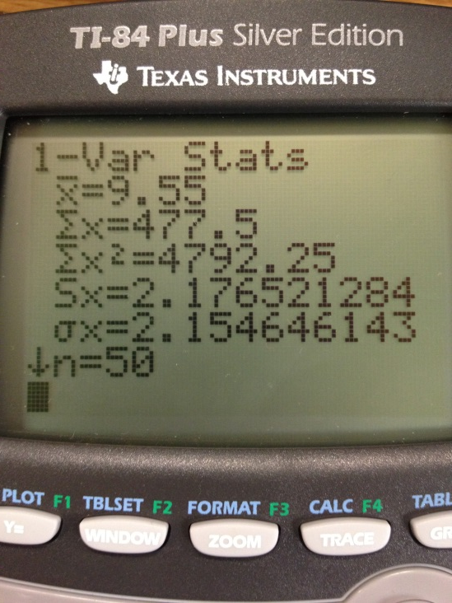
Range and Standard Deviation
Range: the difference between the lowest and the highest values
Standard Deviation: a measure on how you spread out the numbers; square root of the variance
13-5 = 8

Slide 7
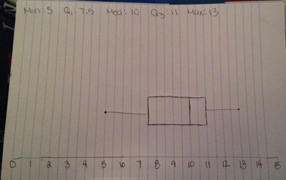
Box & Whisker Plot
Box & Whisker Plot: a graphic way to display the median, quartiles, and extremes of a data set on a number line to show the distribution of the data.

Slide 8
Conclusion????
In Lake Shore High School the most common shoe size 10.5. With a close second at size 7.

