Slide 1
The Time Students Wake Up In The Morning For School With Probability and Statistics

Slide 2
During this survey, I went up to 50 random students and asked each one what time they woke up in the morning for school .These are the results I got…..

Slide 3
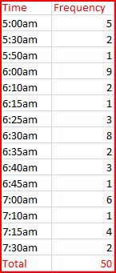
Frequency Table
How is done: We list the values in one column and the frequency of the values in another column.

Slide 4
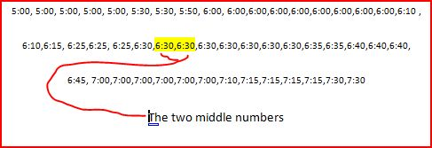
Finding The Median
How its done: You can find the Median by looking at the middle score. But if the data is a even number you take the two middle numbers and add them ,next you divide the two added numbers by 2.

Slide 5
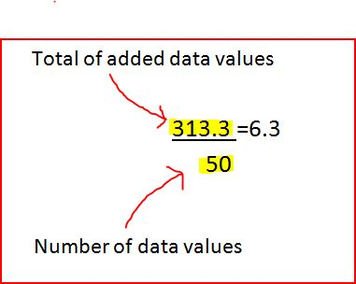
Finding The Mean
How its done: First we add the data values. Then We take the total of the data value and divide it by the number of data values.

Slide 6
Finding The Range
How its done: subtract the highest and smallest value numbers.

Slide 7
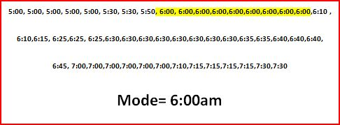
Finding The Mode
How its done: It’s the number that accrues more.

Slide 8
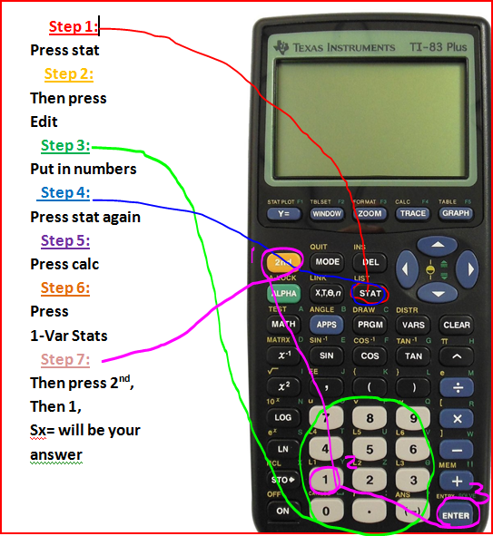
Finding Standard Deviation
My standard deviation from my results from the survey is……
Sx= .64643

Slide 9
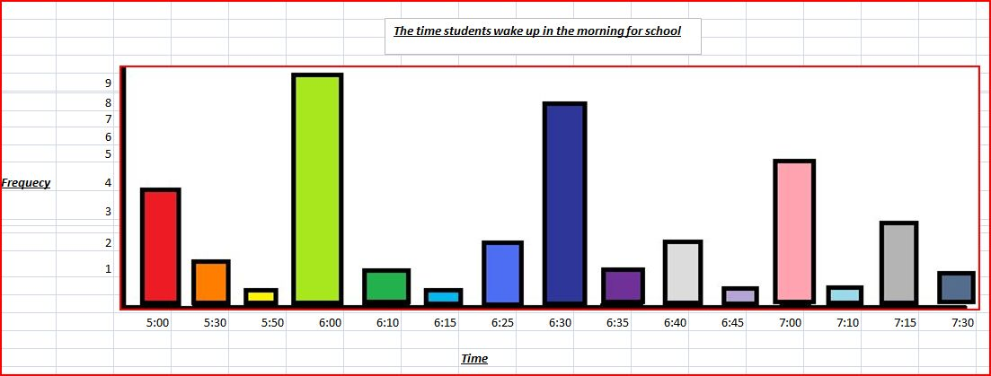
Bar Graph

Slide 10
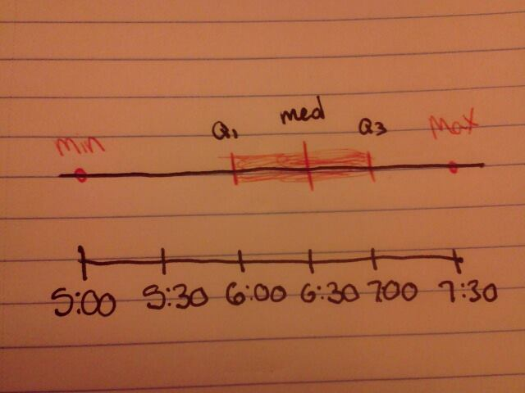
Box And Whisker Graph

Slide 11
I personally can conclude from my data that most students wake up for school at 6:00am in the morning. Me personally I wake around 6:30.

