Slide 1
14.4 The Normal Distribution
Probability and Statistics

Slide 2
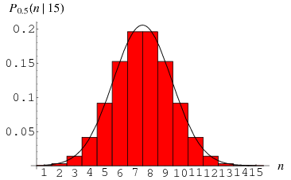
Normal Distribution or Normal Curve
Most common distribution in real-life and in statistics
Curve Shaped
AKA: Bell-Curve

Slide 3
Properties of a Normal Distribution
A normal curve is bell shaped.
The highest point on the curve is at the mean of the distribution. (also median and mode)
The mean, median, and mode of the distribution are the same.
The total area under the curve is 1.
The 68-95-99.7 Rule

Slide 4
The 68-95-99.7 Rule
68% of the data is within 1 standard deviation of the mean (highest point). This means there is 34% on each side.
95% of the data is within 2 standard deviations of the mean. This means that there is 47.5% on each side.
99.7% of the data is within 3 standard deviations of the mean. This means that there is 49.85% on each side.

Slide 5
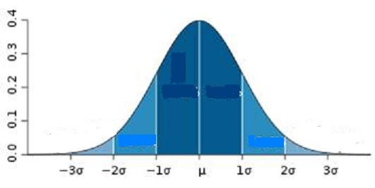
The 68-95-99.7 Rule
34%
34%
2.35%
2.35%
13.5%
13.5%
68 %
95 %
99.7 %
Nearly all (99.7%) of the values lie within 3 standard deviations of the mean (or between the mean minus 3 times the standard deviation and the mean plus 3 times the standard deviation).

Slide 6
EXAMPLE:
Suppose a distribution of 1,000 scores represent scores on a standardized test. The mean of the distribution is 450 and the standard deviation is 25.
How many scores do we expect to fall between 425 and 475?
How many scores do we expect to fall above 500?

Slide 7
Part 1
If the mean is 450, then 425 and 475 represent one standard deviation below and one standard deviation above the mean. This falls with 68% of the data.
So… 68% of 1000 is: .68 x 1000 = 680
So 680 scores are in the range of 425-475.

Slide 8
Part 2
500 represents 2 standard deviations above the mean.
95% of our data falls within that range.
We want to find the values above 500.
This would be represented by (1/2) of 5% or 2.5% of the data.
So, 2.5% of 1000 scores = .025 x 1000 = 25
25 scores would be above 500.

Slide 9
Assignment:
pg. 831
#6-16 even

Slide 10
14.4. Notes Part 2

Slide 11
Z-Scores
Represents the number of standard deviations a data value is from the mean.
Positive above mean, negative below mean
In the last example, we said that 500 was 2 standard deviations above the mean (the mean was 450 and standard deviation 25)…
What would be the z-score?
Z = 2

Slide 12
Z-Scores
The z-score table can be used for both positive and negative z-scores.
The table tells you “A” - represents the area underneath the curve. (Remember that the area underneath the entire curve is 1 .. 100%).
Area represents the percentage of scores within the specified range.
For example, a z-score of 1 (1 standard deviation above the mean) shows an area of 0.34
34% of the data is 1 standard deviation above the mean…

Slide 13
Finding Areas under a Normal Curve
Using your z-score table, find the percentage of data (area under the curve) that lie in the following regions for a standard normal distribution: *draw a diagram for each!
A). Between z = 0 and z = 1.3
B). Between z = 1.5 and z = 2.1
C). Between z = 0 and z = - 1.83

Slide 14
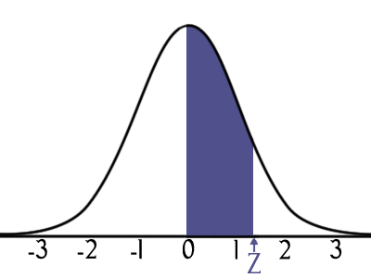
A). Between z = 0 and z = 1.3
By the z-score table, I look at z = 1.3
The area of the region is .403
This means 40.3% of the data will fall within this range.

Slide 15
B). Between z = 1.5 and z = 2.1
Z= 1.5 43.3% (represents between z=0 and z=1.5)
Z=2.1 48.2% (represents between z=0 and z=2.1)
So between those scores (1.5 – 2.1) we need to subtract.
48.2-43.3 = 4.9%
*SSS (same-side-subtract)

Slide 16
C). z = 0 and z = -1.83
Since the data is evenly distributed on both sides of the mean (z=0), just look up 1.83 on your chart. z = 1.83 same as z = -1.83, just on opposite sides of the mean…
Z=1.83 46.6%

Slide 17
Assignment
14.4 Worksheet

Slide 18
Converting Raw Scores to Z-Scores
Value
Mean
Standard Deviation

Slide 19
Examples:
Suppose the mean of a normal distribution is 20 and its standard deviation is 3. *draw a diagram to represent each situation, and answer the question.
a). Find the z-score that corresponds to a raw score of 25.
b). Find the z-score that corresponds to a raw score of 16.
c). Find the raw score that corresponds to a z score of 2.1

Slide 20
Suppose the mean of a normal distribution is 20 and its standard deviation is 3. a). Find the z-score that corresponds to a raw score of 25.

Slide 21
Suppose the mean of a normal distribution is 20 and its standard deviation is 3. b). Find the z-score that corresponds to a raw score of 16.

Slide 22
Suppose the mean of a normal distribution is 20 and its standard deviation is 3. c). Find the raw score that corresponds to a z score of 2.1
+20 +20
26.3 = x

Slide 23
Suppose the mean of a normal distribution is 25 and its standard deviation is 5.
Find the percentage of values that fall between: **draw diagram for each..
25 and 29
22 and 25
Under 17

Slide 24
Percentile
If the mean salary for teachers is $55,000 with a standard deviation of $5000, to what percentile does your salary of $49,000 correspond?
Your friend’s salary of $63,000?

Slide 25
The heights of 5th graders have a mean of 4’8’’ and standard deviation of 2’’. If there are 100 5th graders, how many will be:
Over 5’ tall?
Under 4’5’’ tall?

Slide 26
ASSIGNMENT:
Pg. 831
#18-34 even, #44-54 even, 65, 66, 79, 80

