Slide 1
14.3 Measures of Dispersion
Compute the range of a data set
Calculate the standard deviation of a distribution
Understand how the standard deviation measures the spread of a distribution
Use the coefficient of variation to compare the standard deviations of different data sets

Slide 2
How spread is the data?
Imagine you are shopping for a pacemaker battery for a loved one.
You have two choices:
Choice A has a mean of lasting 45,000 hours and Choice B has a mean of lasting 46,000 hours.
Is this an easy choice? Is mean the best measure? What else might you want to know?

Slide 3
I WOULD WANT CONSISTENCY!!
Choice A’s values were within the 44,500-45,500 hour range. This means all the data values were within 500 hours of the mean.
Choice B’s values were within 43,500-48,500 hour range. This means all the data was within 2500 hours of the mean.
Now which one would you choose?

Slide 4
Range
Measure of dispersion
Difference between the largest and smallest value in a data set
Example:
Quiz Scores for Jill:
74,75,76
Example:
Quiz Scores for Jack:
50,75,100
Range: 76 - 74
Range = 2
Range: 100 - 50
Range = 50

Slide 5
Deviation
In mathematics and statistics, deviation is a measure of difference between the observed value of a variable and that variable's mean.
Standard deviation is the frequently used measure of dispersion: it uses squared deviations.

Slide 6
Deviation
How far is x from the mean?
number
mean
x
16
14
12
21
22

Slide 7
16 | 16-17 = - 1
14 | 14- 17 = -3
12 | 12-17 = -5
21 | 21-17 = 4
22 | 22-17 = 5

Slide 8
Standard Deviation

Slide 9
Computing the Standard Deviation
Compute the mean of the data set; call it
Find for each score in the data set.
Add the squares found in step two and divide the sum by n-1. This is called the variance.
Compute the square root of the number found in step 3.

Slide 10
Mean is 17
16
14
12
21
22

Slide 11
16 | -1
14 | -3
12 | -5
21 | 4
22 | 5

Slide 12
16 | -1 | 1
14 | -3 | 9
12 | -5 | 25
21 | 4 | 16
22 | 5 | 25

Slide 14
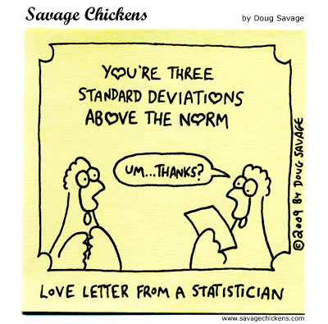
Assignment: Pg. 815 #6-14 EVENS you need to make the table to show how you find standard deviation

Slide 15
Notes Part 2

Slide 16
SAMPLE STANDARD DEVIATION FOR A FREQUENCY DISTRIBUTION:

Slide 17
x Closing Price | f Frequency | Product
37 | 1
38 | 2
39 | 5
40 | 5
41 | 4
42 | 2
44 | 1

Slide 18
x Closing Price | f Frequency | Product
37 | 1 | 37
38 | 2 | 76
39 | 5 | 195
40 | 5 | 200
41 | 4 | 164
42 | 2 | 84
44 | 1 | 44

Slide 19
x Closing Price | f Frequency | Product | (x -40) Deviation | Deviation Squared | Product
37 | 1 | 37
38 | 2 | 76
39 | 5 | 195
40 | 5 | 200
41 | 4 | 164
42 | 2 | 84
44 | 1 | 44

Slide 20
x Closing Price | f Frequency | Product | (x -40) Deviation | Deviation Squared | Product
37 | 1 | 37 | -3 | 9
38 | 2 | 76 | -2 | 4
39 | 5 | 195 | -1 | 1
40 | 5 | 200 | 0 | 0
41 | 4 | 164 | 1 | 1
42 | 2 | 84 | 2 | 4
44 | 1 | 44 | 4 | 16

Slide 21
x Closing Price | f Frequency | Product | (x -40) Deviation | Deviation Squared | Product
37 | 1 | 37 | -3 | 9 | 9
38 | 2 | 76 | -2 | 4 | 8
39 | 5 | 195 | -1 | 1 | 5
40 | 5 | 200 | 0 | 0 | 0
41 | 4 | 164 | 1 | 1 | 4
42 | 2 | 84 | 2 | 4 | 8
44 | 1 | 44 | 4 | 16 | 16

Slide 23
Standard Deviation on the calculator
Enter your data into a list
Go to Stat, Calc, and do 1-Var stats (like you do for 5 number summary)
You will see both the standard deviation for a sample (Sx)

Slide 24
Coefficient of Variation
Standard deviation
Mean
We use this to compare the standard deviations of different sets of data.

Slide 25
Example:
Data set of Pre-School Weights
Data set of NFL Lineman Weights
We would say that because the coefficient of variation is larger for the preschoolers, we conclude that there is more variation, relatively speaking, in their weights compared to the weights of the football players.

Slide 26
Assignment
Pg. 816 #18, 20, 26, 36, 38

